Slide 1

SOFT WG Update
14.08.2020

Slide 2

State of the spec
Added a section allowing limited-scope implementations
Finalised security considerations
Cursed at the amount of features…
We found the spec to work :)

Slide 3
Interoperability
| SOFT|SOFT R2FT|R2FT R2FT|SOFT SOFT|R2FT
| Handshake yes yes - -
| Multiple server sessions yes unstable - -
| Single server session yes yes - -
| Serial file transfer yes yes - -
| Parallel file transfers yes yes - -
| SHA512 Hash Check yes yes - -
| Out-of-order reception yes unstable - -
| Retransmissions yes unstable - -
| Induce Packet Loss param no no - -
| Congestion Control no no - -
| Flow Control no unstable - -
| File List Operation no no - -
| Error Reporting yes yes - -
| File Resume no no - -
| Permission Metadata no no - -

Slide 4

Rust SOFT
Protocol Design SS20 - Johannes Abel, Joseph Birkner, Peter Okelmann

Slide 5

R2FT
Language: Rust
Test Coverage: 64%
Lines of Code: 3229
Lines of Comments: 301
Server: cargo run -- -s
Client: cargo run -- 127.0.0.1:42424 testdata/test.txt
Public Repo: https://gitlab.pogobanane.de/pogobanane/r2ft
Notes:
Test coverage: lots of unused tlvs...

Slide 6
Dependencies
[dependencies]
clap Command line parsing
env_logger Simple Logger
log Logging macros
byteorder Read and write depending on Endianness
leb128 Read and write LEB128 numbers
rand Random number generation
sha3 SHA3 calculation
itertools Convenience tools for iterators
num For conveniently converting enums numbers
num-derive “
num-traits “
External code (MIT license), modified for our fnv1a32 calculations: https://github.com/althonos/pruefung/blob/master/src/fnv/fnv32.rs

Slide 7
Module Structure
r2ft Library crate
├── app SOFT application layer stuff
│ ├── frame TLVs + (de-)serialization
│ ├── get File retrieval client (run method)
│ ├── ls File list retrieval client (run method)
│ ├── server Runs Server (run method)
│ └── state State machine for sending and receiving chunks
├── common Some useful stuff for both layers, mainly traits and macros for TLV parsing
│ ├── fnv1a32 Calculation of FNV1a32
│ └── mtu MTU from OS retrieval
├── options Command line options parsing
└── transport SOFT transport layer stuff
├── client Creating a client connection to a server
├── common Transport-global definitions
├── connection Connection interface
├── frame (De-) Serialization of UDP messages
├── jobs Jobs for sending and receiving Objects over a Connection
└── server Listening for incoming connections as a Server
main Binary crate for command line program

Slide 8
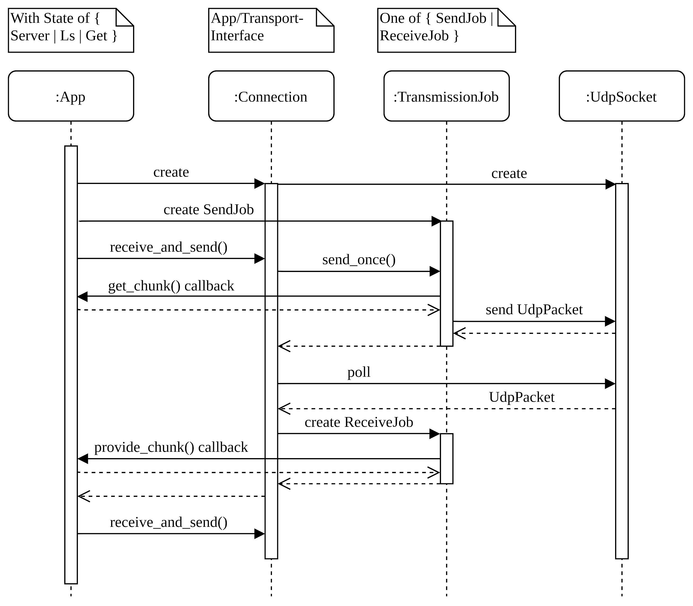
Control Flow

Slide 9
Peter Okelmann: Interface
Interface: Transport - App
Goal: Allow concurrent implementation of both parts.
Design Decisions:
Sync vs async rust
Choose UdpSocket impl (std, std+thread, mio/poll, tokio, libc)
-> std::UdpSocket.set_nonblocking()
Collaboratively single-threaded vs threaded
Notes:
with help of joseph: funcionally working
with help of johannes: even compiled

Slide 10
Joseph Birkner: Transport
Server
Client
Application
Application
Listener
socket
1
2
UdpSocket
Connection
send_jobs
recv_jobs
socket
session_id
Connection
send_jobs
recv_jobs
socket
session_id
3
Connection
send_jobs
recv_jobs
socket
session_id
Connection
send_jobs
recv_jobs
socket
session_id
UdpSocket
4
UdpSocket

Slide 11
Johannes Abel: Application
Command line parsing done in main
Results in call to server's run or client's get method
both (client + server) init
  state machine (abstracts SOFT application layer)
    manages application layer closures and state
  connection (abstracts SOFT transport layer)
    directly (connect) by client, via busy wait (listen) by server

Slide 12
Johannes Abel: Application
both run loops
  get closures with corresponding state from app to transport
  fetches send jobs from application to transport (get closure/ callback on state)
  register new receive jobs from to application (get on state)
  periodically call connection.receive_and_send() at connection/ transport layer
  progresses send and receive of jobs via callbacks
client creates initial SendJobs for file request

Slide 13
Johannes Abel: Application
Symmetrical application state machine implementation
Allows server to retrieve files from client ¯\_(ツ)_/¯
Client, Server
Application
update, sync
State Machine
push_send_job()
push_recv_job()
Connection
send_jobs
recv_jobs
SendJob::chunk_callback()
RecvJob::chunk_received_callback()

Slide 14
🧡
Demo Time!
Any Questions?

